Slide 1
Market Outlook & Asset Management
– A Global Perspective
Pramerica International Investments Advisers, LLC. (“Pramerica”)
John Praveen, Ph.D
Managing Director, Pramerica International Investments Advisers, Newark, USA
Member, Board of Trustees, DHFL Pramerica Asset Managers, Mumbai, India
September 20, 2016
Pramerica is a brand name (or trade name) used by Prudential Financial, Inc. (“PFI”) in select countries outside the US. For purposes of this
presentation, all references to Prudential have been replaced with Pramerica. No part of this material may be reproduced or distributed further without the written approval of Pramerica. PFI is not affiliated in any manner with Prudential plc, a company incorporated in the United Kingdom.
For informational use only. Not intended as investment advice

Slide 2

Global Financial Markets
Developed & Emerging
Past Performance & Future Outlook
Notes:
2

Slide 3
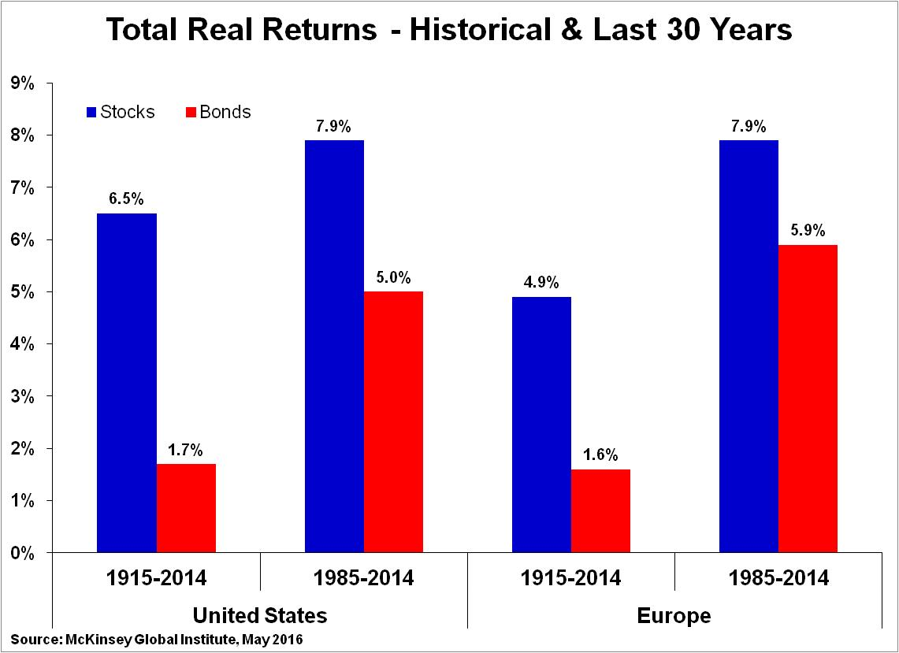
Bull Market in Stocks & Bonds Over Last 30 Years with a Confluence of Positive Economic, Business & Policy Factors
Market Outlook & Asset Management – A Global Perspective
Higher Returns for Stocks & Bonds over Last 30 Years relative to Long-term Average
U.S. Equities
Source: McKinsey Global Institute, May 2016
European Equities
U.S. Bonds
European Bonds
Source: McKinsey Global Institute, May 2016

Slide 4
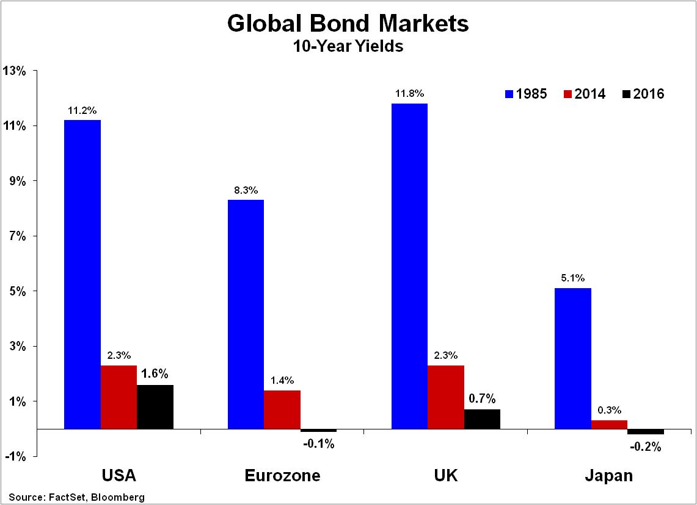
Bull Market in Bonds as Yields in Secular Down-Trend
Demographic Factors, Falling Inflation, Rate Cuts & Central Banks Buying, Safe Haven Demand Push Yields Lower
Market Outlook & Asset Management – A Global Perspective
Data as of 09/15/2016

Slide 5
Bond Market Gains Fuelled by Demographic Factors, Falling Inflation, Rate Cuts & Central Banks Buying
Market Outlook & Asset Management – A Global Perspective
Data as of 09/15/2016

Slide 6
Rally in Global Stock Markets
Fuelled by Low Interest Rates & Liquidity, Low Inflation & Falling Bond Yields leading to P/E Expansion, Solid GDP Growth & Rising Profits
Market Outlook & Asset Management – A Global Perspective
Data as of 09/15/2016

Slide 7
After Solid Growth Rates for Decades, GDP Growth Downshifts in Developed Economies
Growth Upshifts in Emerging Economies
Market Outlook & Asset Management – A Global Perspective
Data as of 09/15/2016

Slide 8
    After Above Average Returns Over Last 30 Years, More Modest Future Returns Likely in Developed Markets
Market Outlook & Asset Management – A Global Perspective
A Confluence of Positive Economic, Business & Policy Factors Fuelled Higher Returns on Stocks & Bonds over the Last 30 Years
These Tailwinds are Unlikely to Continue in the Future
More Modest Stock & Bond Market Gains in Developed Markets
Inflation: Less Room for Inflation to Fall Further
Policy: Limited Room for Rate Cuts or Balance Sheet Expansion with Rates Already Very Low / Negative & Balance Sheets Bloated
Bond Yields: Limited Room for Yields to Fall Further
GDP Growth: GDP Growth Downshifting with Slower Productivity Gains & Employment Growth with Ageing Populations
Corporate Profits: Weaker Corporate Profits with Slower GDP Growth, Competition from Emerging Markets & Technology
Data as of 09/15/2016

Slide 9
Outlook & Strategies in Low Return, More Correlated Markets
Market Outlook & Asset Management – A Global Perspective
Bond Markets:
Bonds may not enjoy Cyclical Tailwinds of Falling Inflation, Further Rate Cuts & Central Bank Buying
In Fact, Bond Yields in Developed Markets Could Rise with Central Bank Rate Hikes
However, Bonds still Supported by:
Structural Tailwinds of Changing Demographics
  Buying by Aging & Retiring Baby Boomers Remains Powerful Tailwind for Bonds
Negative Rates in EU & Japan & Investors Search for Yield
  Likely to Benefit Emerging Market Debt, Corporate & High Yielding Bonds, U.S. Treasuries & UK Gilts
Data as of 09/15/2016

Slide 10
Outlook & Strategies in Low Return, More Correlated Markets
Market Outlook & Asset Management – A Global Perspective
Stock Markets:
    Developed Stocks Markets likely to Post More Modest Returns in the Future with Slower GDP Growth, Weaker Profit and Less Support from Central Bank Rate Cuts & Liquidity
Consequently, Equity Investors are Likely to Look for Opportunities in:
  Other Equity Markets
    Emerging Markets – Especially India
  Other Products
    ETFs & Passive Investing
    High Active Share Strategies
    Multi-Asset & Quant Products
Data as of 09/15/2016

Slide 11
Emerging Markets likely to Offer Opportunities for Higher Returns Relative to Low Returns in Developed Markets
Market Outlook & Asset Management – A Global Perspective
Data as of 09/15/2016

Slide 12
Emerging Markets likely to Enjoy Higher Returns with Solid GDP Growth & Rising Profits, Falling Inflation & Scope for Rate Cuts, Lower Bond Yields & P/E Expansion
Market Outlook & Asset Management – A Global Perspective
Data as of 09/15/2016

Slide 13
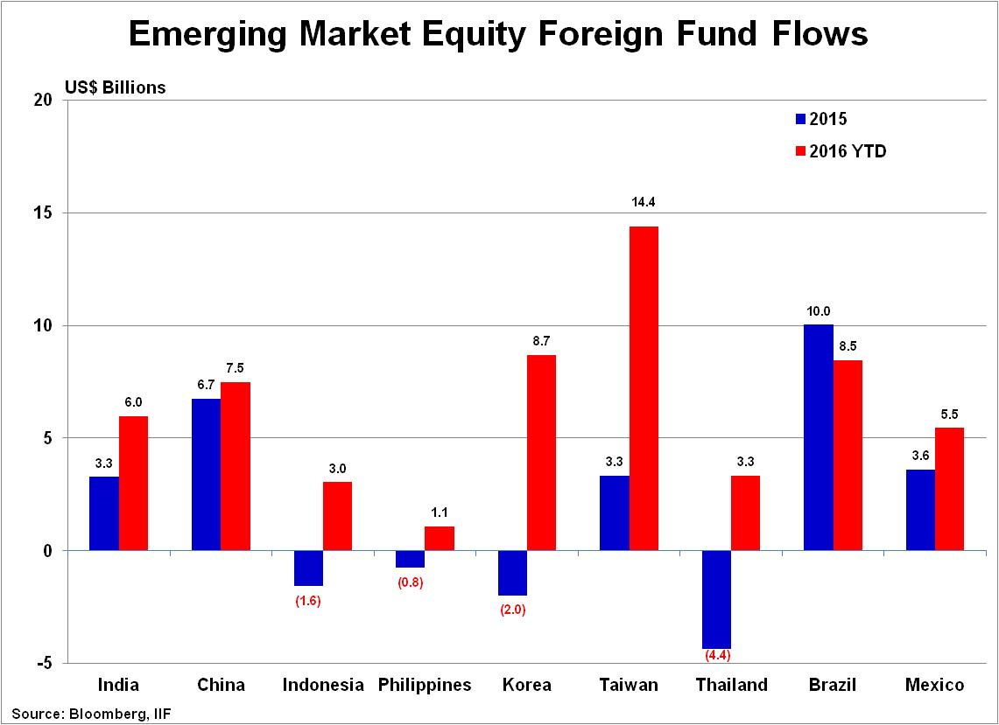
Among Emerging Markets, India has Attracted Strong Capital Flows
Market Outlook & Asset Management – A Global Perspective
Solid Foreign Capital Inflows combined High Savings, Favorable Demographics & Sound Domestic Policies should Enable India to Enjoy Higher GDP Growth Rates & Market Returns
Data as of 09/15/2016

Slide 14
Market & Asset Management Trends
Notes:
14

Slide 15
Increased Correlations Between Assets & Markets
Secular Increase in Correlations between Markets & Asset Classes Resulting from Integration of Global Economies & Capital Markets
Increased Correlations & Globalization of Markets have Reduced Diversification & Cross-Market, Cross-Asset Arbitrage Opportunities
Market Outlook & Asset Management – A Global Perspective
Data as of 09/15/2016
Notes:
This secular increase of cross-regional equity correlation is a result of the integration of global economies and capital markets. Liberalization of flows of goods between economies (free trade, outsourcing of labor), the rise of Emerging Markets (e.g., BRICS), and globalization of the financial industry (e.g., global banks and hedge funds) all contributed to the increase of cross-regional correlations. While th

Slide 16
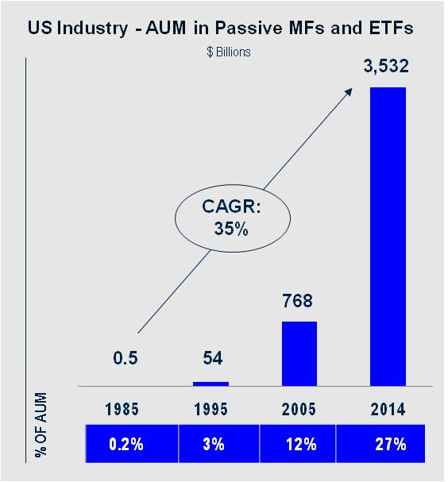
Trends in Asset Management Industry
Growth of ETFs & Passive Investing
Market Outlook & Asset Management – A Global Perspective
Source: Goldman Sachs, June 2015
Source: Simfund
Data as of 09/15/2016

Slide 17
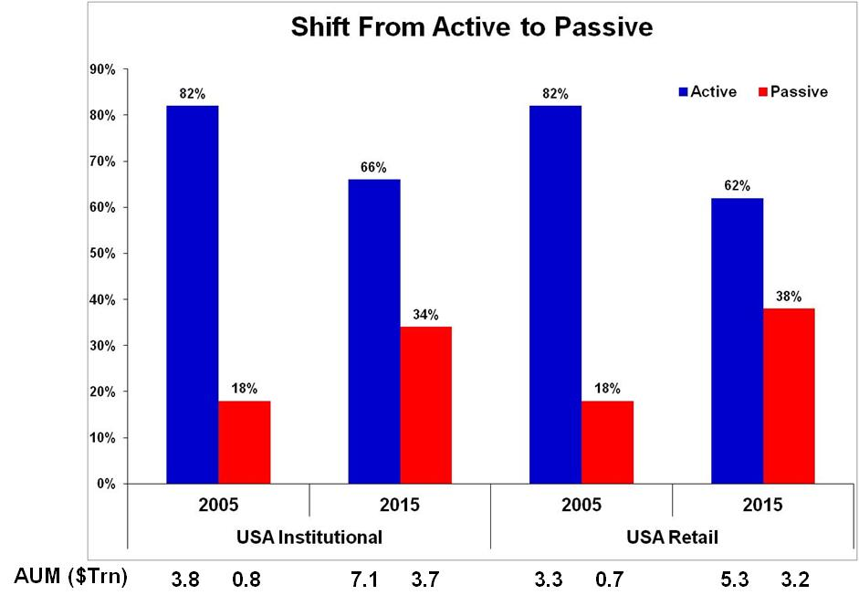
Trends in U.S. Asset Management Industry
Rise of Passive Investing - Shift from Active to Passive
Market Outlook & Asset Management – A Global Perspective
Data as of 09/15/2016
Notes:
Passive share of US Institutional AuM in equities increased from 18% in 2005 to 34% in 2015, with a 7 percentage point gain between 2011 and 2015
Passive share may be under-represented due to managers self reporting assets in eVestment
Active assets grew almost 90% n absolute terms from $3.7tr in 2005 to $7.1tr in 2015. Passive assets grew 340% from $0.83tr to $3.7tr during the same period.
Passive share of US Retail AuM in equities has increased from 18% in 2005 to 38% in 2015
Adoption of ETFs has powered passive trend with the wrapper gaining market share from 7% of AuM in 2005 to 19% in 2015
Active assets grew 61% in absolute terms, from $3.3tr in 2005 to $5.3tr in 2015.
Passive assets grew 350% from $0.72tr to $3.23tr during the same period.
ETF’s grew from $0.28tr to $1.62tr during the same period.

Slide 18
Trends in Asset Management Industry
Market Outlook & Asset Management – A Global Perspective
    Growth of ETFs & Passive Investing Continues with:
        Geographic Expansion:
        70% of $3 Trillion in ETF in USA. Penetration of ETF in EU/APAC remains significantly lower at 5‐6% vs. 14% in US, leaving room for growth
        Retirement Asset Migration:
          DC assets to IRAs, Increasing regulatory scrutiny on fees on managing retirement assets
        Product Innovation:
          Rules‐based investing (Smart Beta, Enhanced Indexing, Quant Strategies) gaining momentum as investors increasingly gravitate toward lower‐cost, factor / rules‐based investing amidst technological advancements, expanding wealth of information ("big data”)
    Goldman Sachs Report: ETFs to grow at a 12-13% annual rate and double to ~$6 Trillion by 2020
    Source: Goldman Sachs, June 2015
Data as of 09/15/2016

Slide 19
Trends in Asset Management Industry
Market Outlook & Asset Management – A Global Perspective
Growth of ETFs & Passive Investing
High Active Share Strategies
Multi-Asset & Quant Products
Data as of 09/15/2016

Slide 20
Market Outlook & Asset Management – A Global Perspective
Summary
Bull Markets in Stocks & Bonds over the Last 30 Years with a Confluence of Positive Economic, Business & Policy Factors
  These Tailwinds Unlikely to Continue in the Future Leading to More Modest Stock & Bond Market Gains in Developed Markets
Bonds
Opportunities in Other Bond Markets (EM Debt, High Yield, Corporate Bonds) as Investors Search for Yield with Low & Negative DM Govt. Bond Yields
Stocks
Opportunities for Better Returns in Other Markets & Products
  Other Markets - Emerging Markets - India
  Other Products - ETFs & Passive Investing, High Active Share Strategies, Multi-Asset & Quant Products
India
Offers Higher Growth Opportunities & Well Positioned Among Emerging Markets to take Advantage of Global Trends
Notes:
GDP Growth
Global GDP Growth Improves in H2 after Weak H1
U.S. GDP Rebound after Q1 Contraction & Soft Q2
Solid U.K. GDP Growth after Soft H1
Further Improvement in Eurozone GDP Growth after Better-than-Expected Growth in H1
Solid GDP Growth in Japan with Fiscal & BoJ Stimulus, Weak Yen Boost to Exports
Improved GDP Growth in EM Asia led by India & Korea. China Stable
Modest GDP Growth in Latin America & EM Europe as Brazil & Russia Bottom
Interest Rates
Fed Rate Lift-off in September 2015. Rate Hikes Gradual & Modest
ECB Continues QE Buying, No Premature Taper. BoE Starts Rate Hikes in Q4 2015
Bank of Japan Expands QE Stimulus
Further Aggressive Stimulus Measures in China
Rate Cuts & Easing Measures by Other Emerging Central Banks
Inflation
Inflation Remains Low in U.S., U.K., & Eurozone
Deflation Risk Recedes as Oil & Commodity Prices Stabilize
Japan Inflation Undershooting BoJ Target
Inflation Low or Falling in Emerging Economies

Slide 21
Disclosure
Market Outlook & Asset Management – A Global Perspective
Pramerica is a brand name (or trade name) used by Prudential Financial, Inc. (“PFI”) in select countries outside the US. For purposes of this presentation, all references to Prudential have been replaced with Pramerica. Pramerica International Investments Advisers, LLC. (“Pramerica”), a PFI company, is an investment adviser registered with the Securities and Exchange Commission of the United States. PFI is not affiliated in any manner with Prudential plc, a company incorporated in the United Kingdom. Pramerica, the Pramerica logo, and the Rock symbol are service marks of PFI and its related entities, registered in many jurisdictions worldwide.
This material has been prepared by Pramerica on the basis of publicly available information, internally developed data and other third party sources believed to be reliable. However, no assurances are provided regarding the reliability of such information. All opinions and views constitute judgments as of the date of writing, and are subject to change at any time without notice. There can be no assurance that any forecast made herein will be actually realized. The data presented is for informational purposes only. The material is intended for the internal business use of select PFI companies and joint ventures. No part of this material may be reproduced or distributed further without the written approval of Pramerica .
The companies, securities, sectors and/or markets referenced herein are included solely for illustrative purposes regarding economic trends and conditions or investment process and may or may not be held by accounts managed by Pramerica affiliates. The global asset and strategy allocation models presented are hypothetical allocation models shown for illustrative purposes only, and does not necessarily reflect the management of any actual account. Following the allocation recommendations presented will not necessarily result in profitable investments. Past performance is not an assurance of future results. Nothing herein should be viewed as investment advice or as a recommendation, solicitation, or an offer to buy/sell any security, or to adopt any investment strategy, nor should it be considered an offer to provide investment advisory or other allocation services.
For more information regarding this document, please contact:
John Praveen, Ph.D
Managing Director, Chief Investment Strategist
Pramerica International Investments Advisers, LLC.
(973) 367-2353
John.Praveen@prudential.com
Follow us on Twitter @prustrategist

